Slide 1


CLOUD NATIVE
BATCH PROCESSING

Slide 2

MICHAEL MINELLA
Lead – Spring Batch &
Spring Cloud Task
JSR-352 - Expert Group Member
Author – Pro Spring Batch
Speaker - JavaOne Rockstar
Podcast - OffHeap Curmudgeon
Twitter - @michaelminella or
@OffHeap

Slide 3


Slide 4

SLIDES AND CODE
WILL BE ON GITHUB SOON

Slide 5

Notes:
Please ask questions when you have them

Slide 6


LAY OF THE LAND

Slide 7

SPRING FRAMEWORK

Slide 8

SPRING BATCH

Slide 9

SPRING CLOUD

Slide 10
SPRING CLOUD TASK

Slide 11

SPRING CLOUD DATA FLOW

Slide 12

Notes:
Today we’re going to look at the most exciting area of IT

Slide 13

Notes:
Batch processing

Slide 14
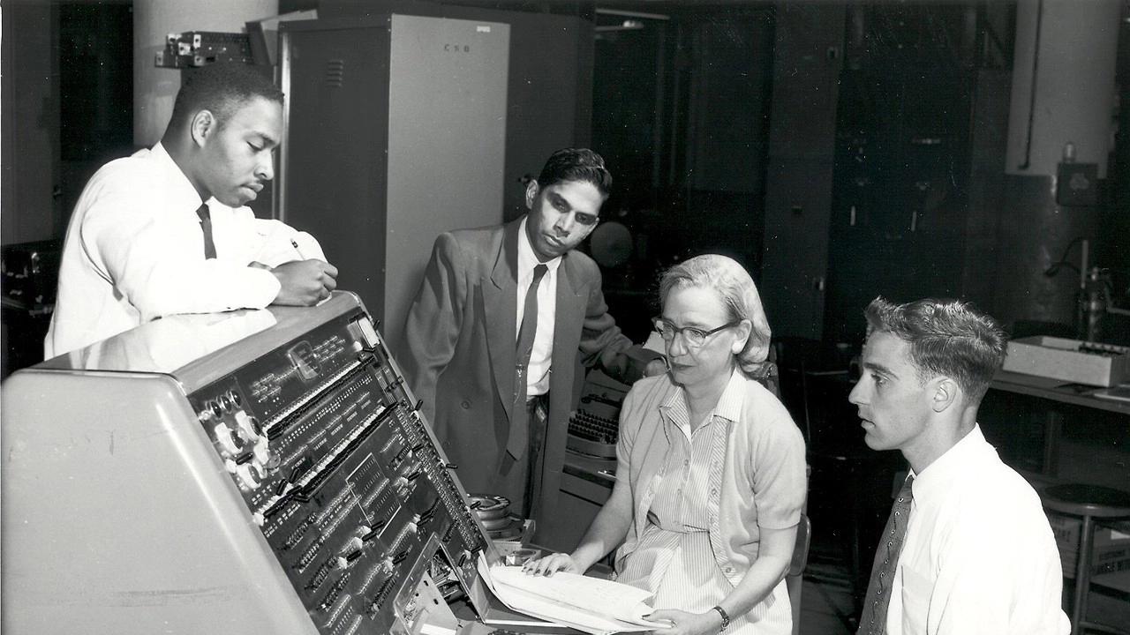
Notes:
While batch processing may be old

Slide 15

BATCH PROCESSING
IS STILL RELEVANT
Notes:
All joking aside, new paradigms still need batch processing:
Orchestration of workloads
ETL
Data Science
IOT

Slide 16

MODERN PATTERNS AND TOOLS
MAKE BATCH A POWERHOUSE

Slide 17




Amazon S3
Import Process

Slide 18
SPRING BATCH

Slide 19
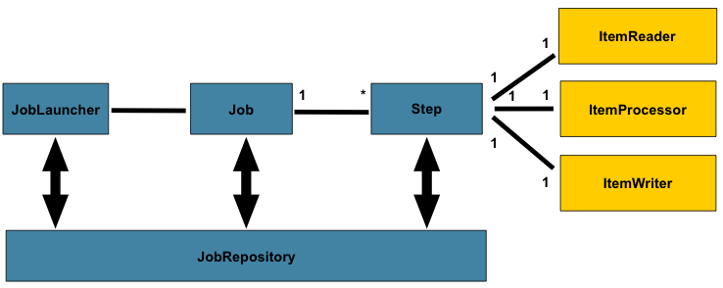
PROVIDES BASIC
BATCH FUNCTIONALITY
Notes:
Spring Batch is 9 years old
A bedrock technology in modern enterprises in every vertical

Slide 20
SPRING BATCH 3.0.7

Slide 21

SPRING BATCH 4.0

Slide 22

First major version since 2014
Notes:
Heartbleed and the iWatch were both new.
First major release since Boot.

Slide 23

SPRING BOOT

Slide 24

8

Slide 25

Notes:
Upgrade all dependencies

Slide 26
SPRING FRAMEWORK 5

Slide 27

ADDING BUILDERS FOR
CONFIGURATION EASE

Slide 28
Amazon S3
Import Process

Slide 29
SPRING BATCH 4.0
Notes:
New features provide added robustness

Slide 30


FlatFileItemReader
JdbcBatchItemWriter
EnrichmentItemProcessor
S3JDBC Job
load
REST Service

Slide 31
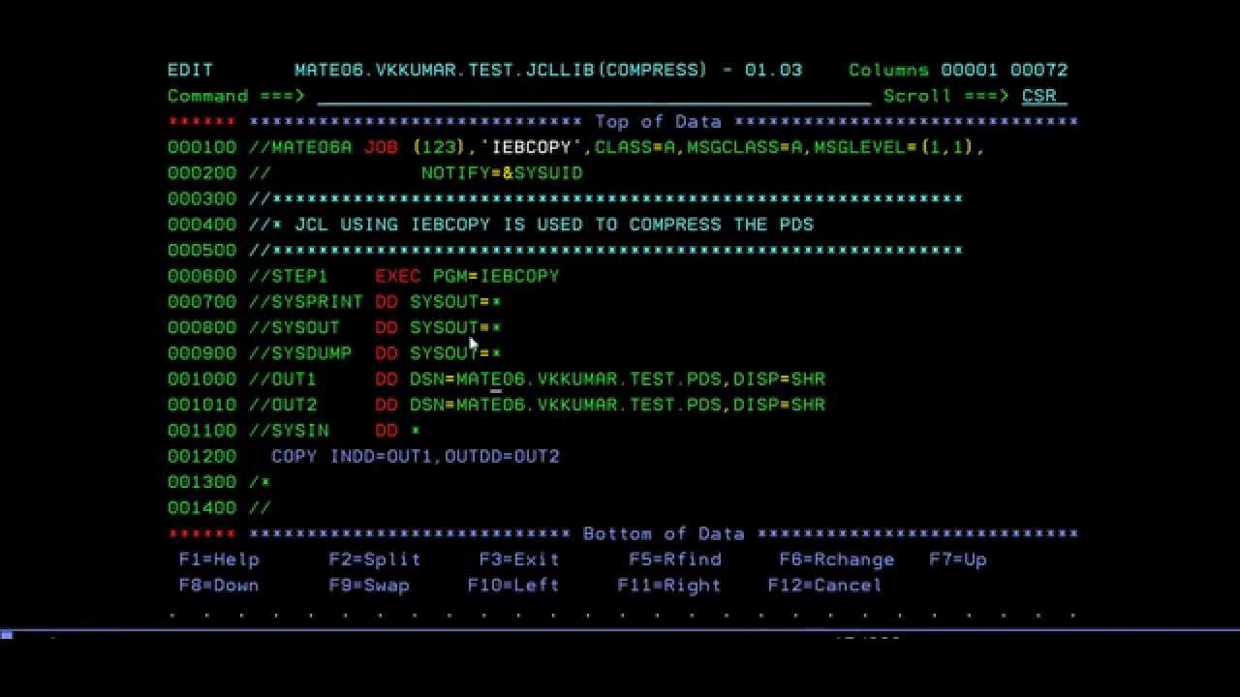
SHOW ME THE
CODE!

Slide 32
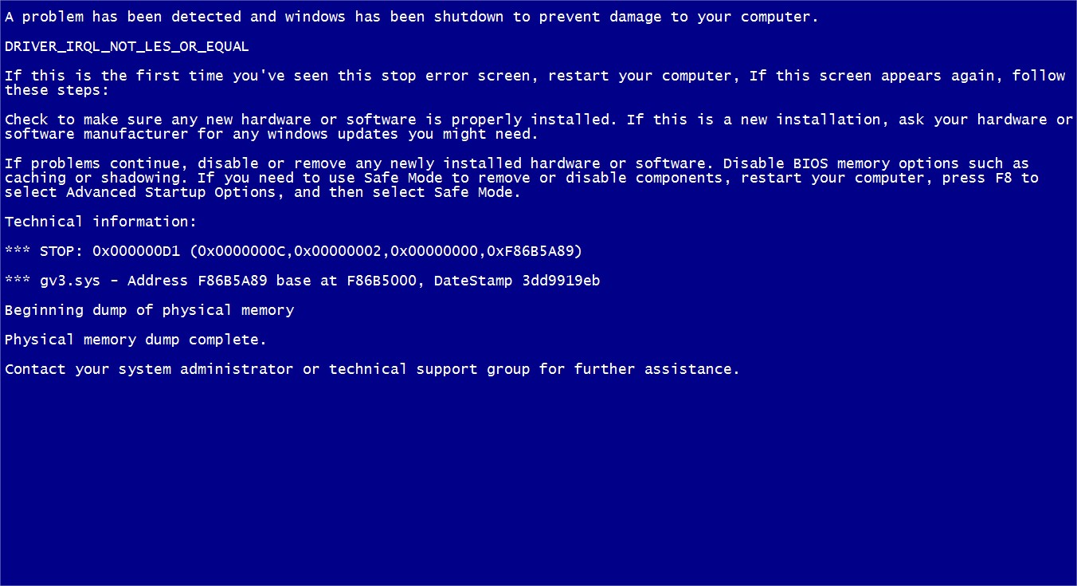

Slide 33
CIRCUIT
BREAKER

Slide 34
SHOW ME THE
CODE!

Slide 35

HOW DO WE CONFIGURE
OUR APP?
How do we configure the app?
Notes:
How do we configure our app?

Slide 36
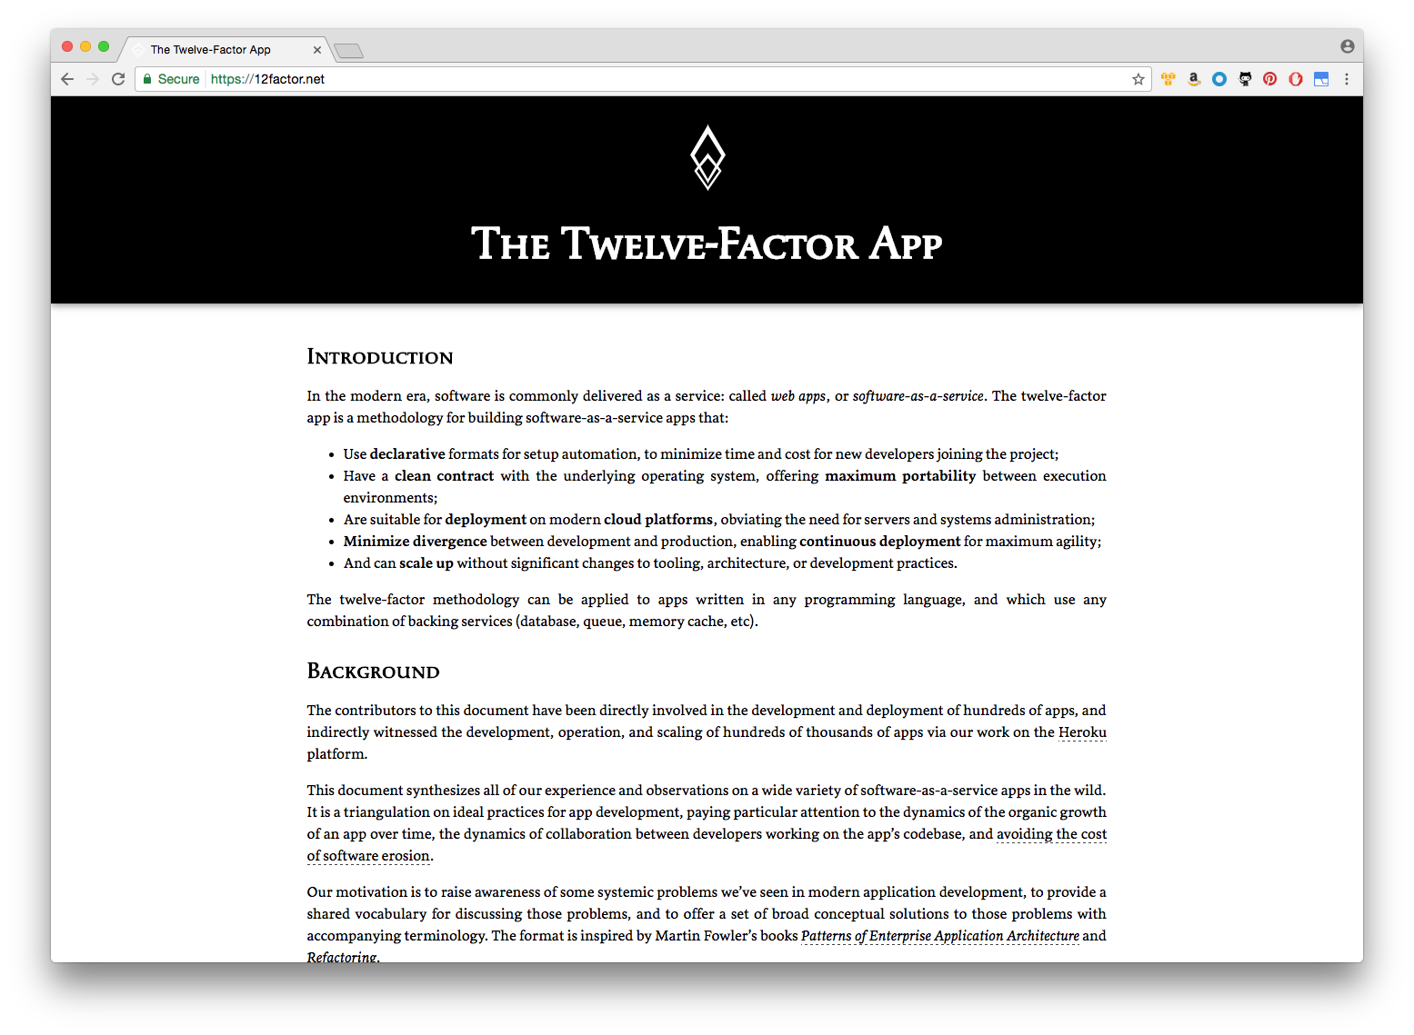
CODE AND CONFIG
SEPARATION

Slide 37

MULTIPLE
APPROACHES

Slide 38
SPRING CLOUD CONFIG SERVER

Slide 39
SPRING CLOUD EUREKA SERVER

Slide 40
Amazon S3
Import Process
Spring Cloud
Config
Spring Cloud
Eureka
REST Service

Slide 41
SHOW ME THE
CODE!

Slide 42

HOW DO WE
SCALE THE APP?

Slide 43
SCALING SPRING BATCH

Slide 44
1
PARALLEL
STEPS

Slide 45
2
MULTITHREADED
STEPS

Slide 46
3
PARTITIONING

Slide 47
4
REMOTE
CHUNKING

Slide 48

WE’LL USE
PARTITIONING

Slide 49
PARTITIONING VIA
SPRING CLOUD
TASK

Slide 50
Amazon S3
master
worker
worker

Slide 51
SHOW ME THE
CODE!

Slide 52

HOW DO WE
ORCHESTRATE?

Slide 53
SPRING CLOUD DATA FLOW

Slide 54
CLOUD NATIVE ORCHESTRATION
TOOL FOR MICROSERVICES

Slide 55
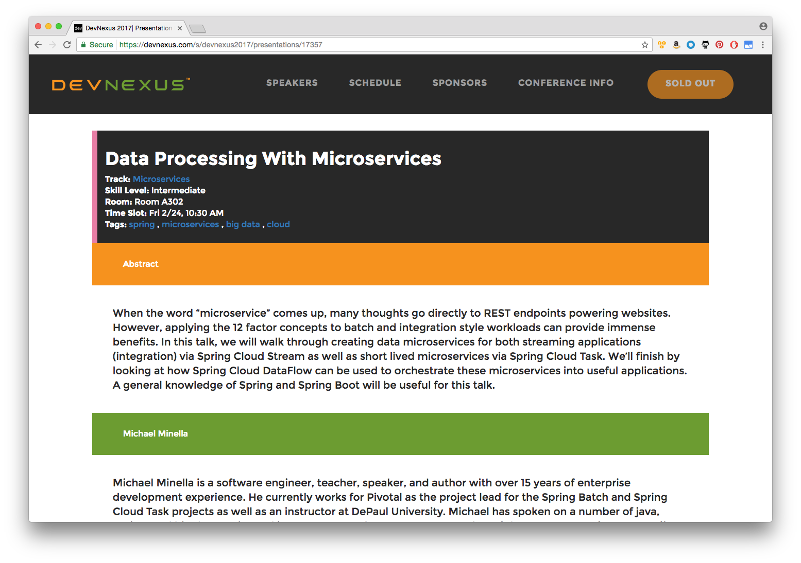

Slide 56

LAUNCH VIA REST,
STREAMS, OR ON DEMAND

Slide 57
SHOW ME THE
CODE!

Slide 58
CLOUD NATIVE WITH SPRING

Slide 59
ALLOW YOU TO TAKE
BATCH PROCESSES

Slide 60
AND DEPLOY
THEM TO THE CLOUD

